Slide 1
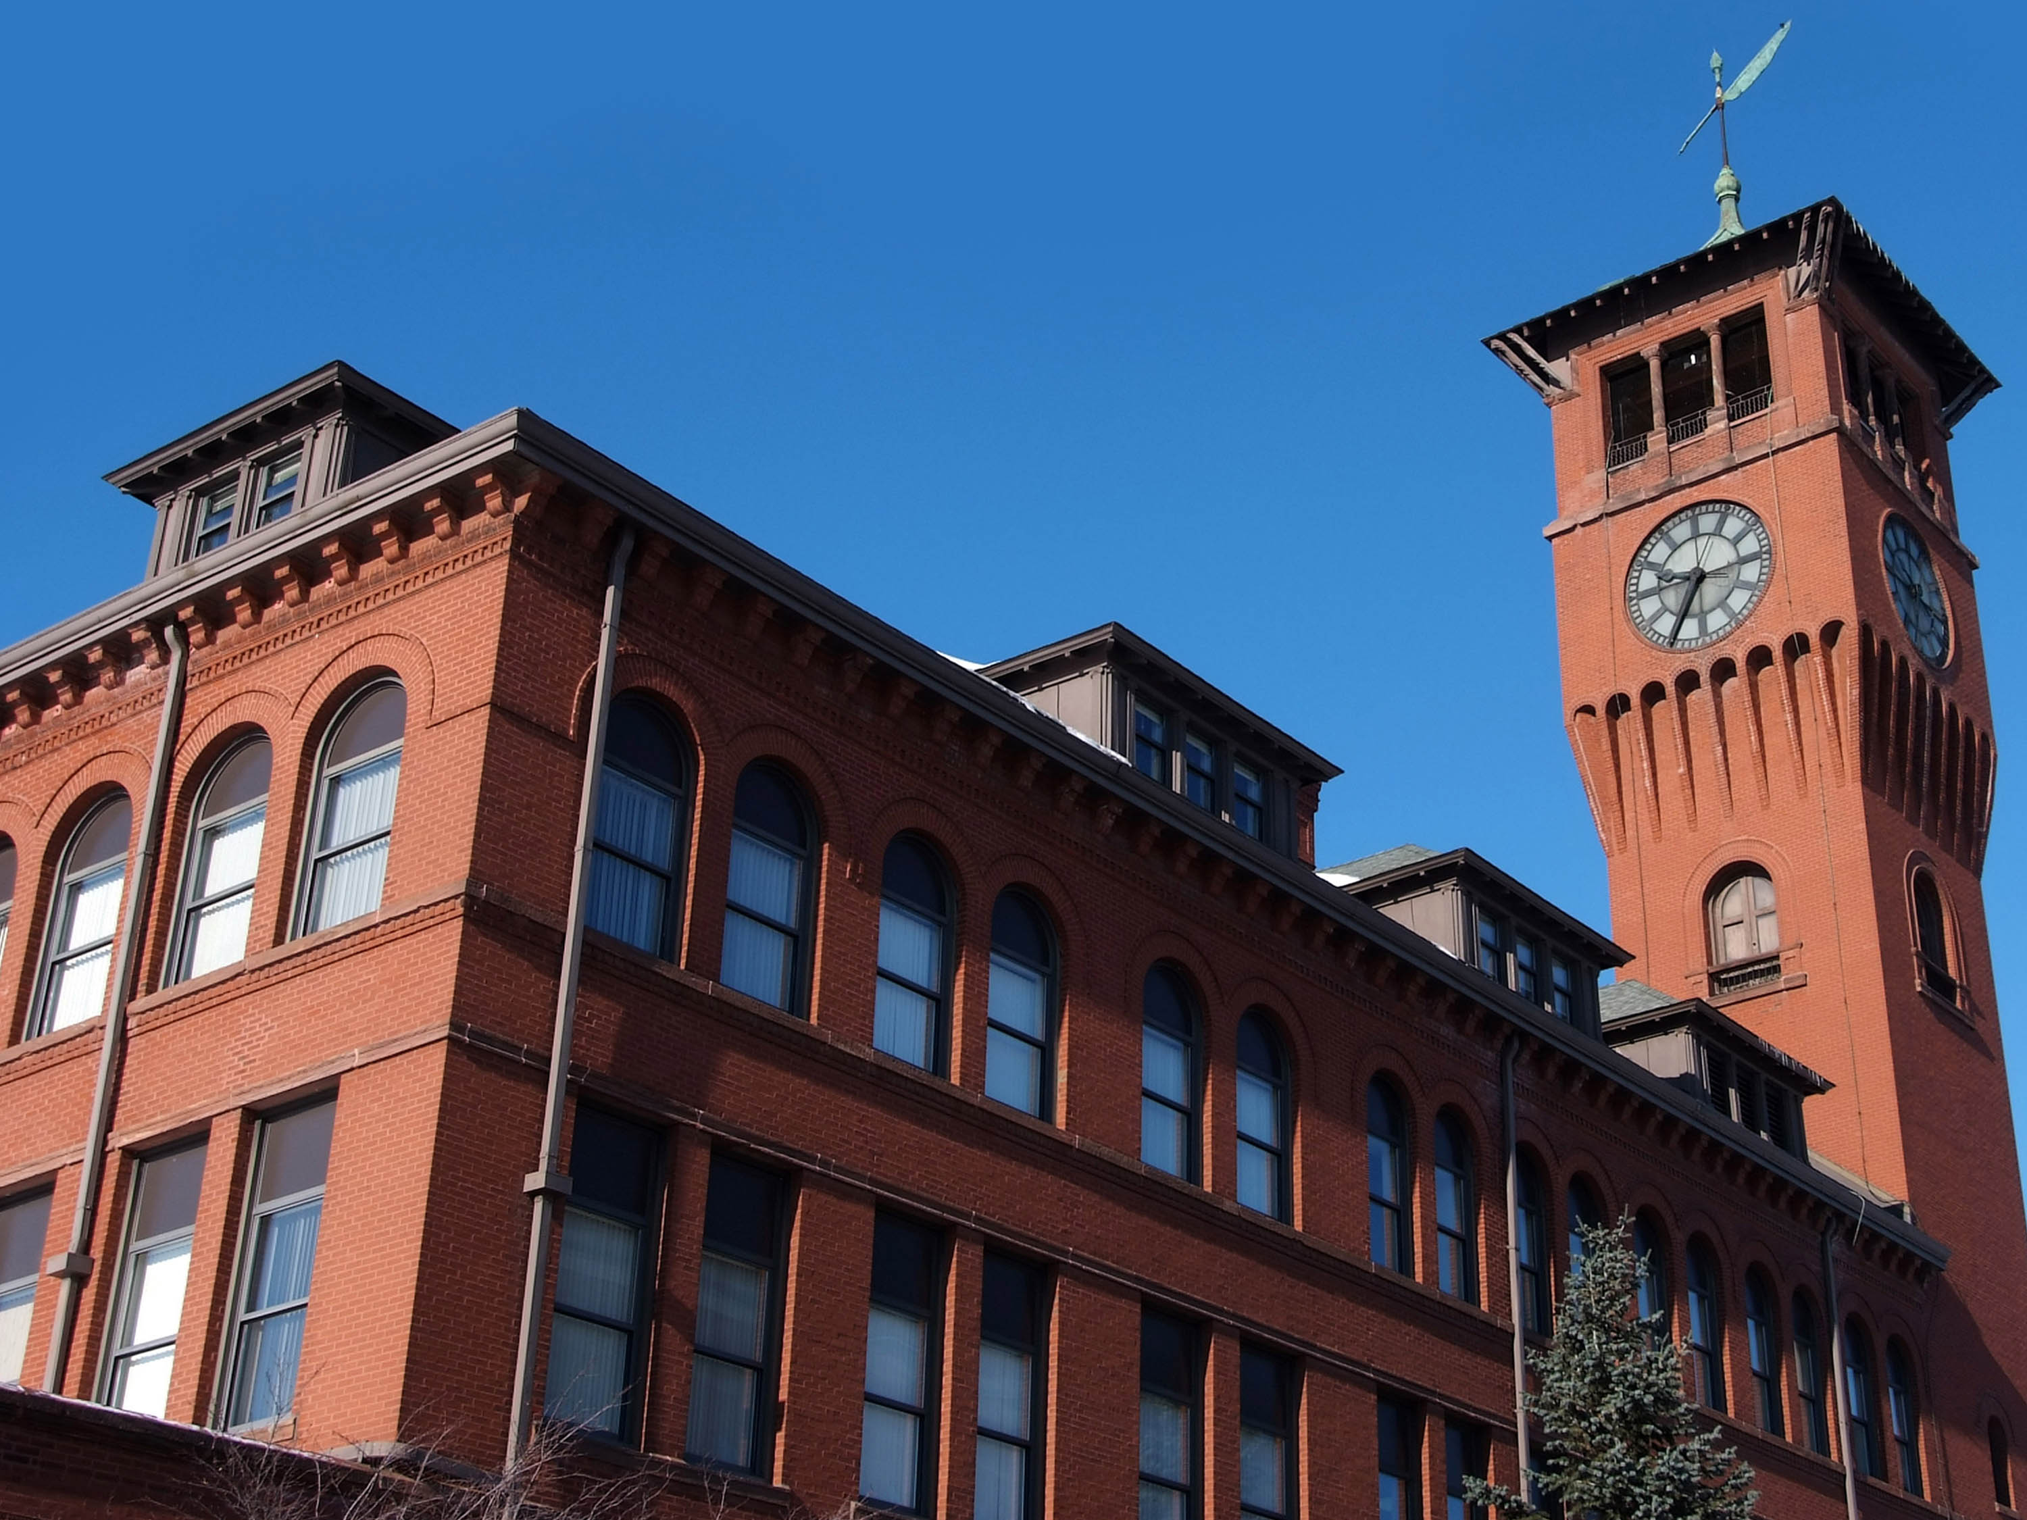

Projectile Motion Experiment and Computational Model
AAPT Winter Meeting
Jan 8, 2018
Todd Zimmerman
University of Wisconsin – Stout
Menomonie, Wisconsin
Inspiring Innovation. Learn more at www.uwstout.edu

Slide 2
Computation and Experiment

Slide 3
University Physics I
23 students
All students have laptops
2 hour labs and 2 hour discussions
3rd VPython activity
Notes:
No TA’s
Two sections per year
Primarily Applied Science and Computer Science students
Typically do an introduction to Vpython – bouncing ball and constant acceleration

Slide 4
SageMath CoCalc
Jupyter Notebooks running at CoCalc.com

Slide 5
Activity

Slide 6
In action
Notes:
Show code

Slide 7
Fresnel’s Equations
Brief hands-on activity (not full fledged lab)

Slide 8
Falling cone

Slide 9
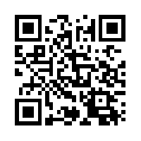
Thank You
Thanks to the UW-Stout Office of Research and Sponsored Programs and to the Nakatani Teaching and Learning Center for financial support
Slides are available at:
https://github.com/zimmermant/SET THIS UP
Notes:
Get correct QR code for this slide.

